Slide 1

Competency-Based Assessment (CBA)
Hands-on training
Presented By: Oluwasanmi Oguntuase, P.Eng.

Slide 2
Table of Content
How professional experience is evaluated within the CBA framework
Roles of validators and assessors in the CBA process.
01
03
Evaluation of work experience
Effective documentation and presentation techniques.
02
04

Slide 3


How professional experience is evaluated within the CBA framework
Review by Validators and Assessors: Validators and assessors examine the applicant's work examples in each competency to assess the breadth, depth, and quality of the provided information.
Competency Rating: Following the review, validators and assessors rate the applicant's competency on a scale of 0-5. A rating of 3 indicates entry-level competency, while a rating of 5 signifies a professional level of competency.
Feedback on Readiness: Additionally, validators and assessors provide feedback on the applicant's readiness for professional registration.

Slide 4
Evaluation of Work Experience
Assessment of Work Examples: Assessors utilize the work examples submitted by the applicant to ascertain the nature and level of work performed.
Relevance to Competency: The assessors evaluate how the work examples relate to the specific competency being addressed by the applicant.

Slide 5
Roles of validators and assessors in the CBA process.
Validators:
Individuals with first-hand, professional knowledge of the applicant’s work (usually a supervisor or colleague).
A validator checks and confirms the accuracy and validity of an applicant’s self-assessment.
A validator verifies that he is familiar with the applicant’s reported experience, rates the applicant's competency level, and provides feedback.
Assessors:
Individuals who conduct competency assessments (a professional engineer (P.Eng.) or geoscientist (P.Geo.)
Assessors are usually anonymous to the applicant.

Slide 6
Effective Documentation/Practical Approach to writing a CBA report
Begin by compiling a list of past/present projects you've worked on and the competencies you believe you've acquired.
Review the list of competencies in the online system and try to match your competencies with those listed.
Draft a summary of the situation for the competency you plan to start with, providing a clear picture of the problem you addressed.

Slide 7
Effective Documentation/Practical Approach to writing a CBA report, Cont’d
Outline the actions you took to solve the problem in a logical sequence, using "I" to describe most of the actions. Also, highlight any collaboration with cross-functional teams.
Describe the outcome of the problem you solved, ensuring it aligns clearly with your outlined situation. Consider quantifying your achievements where possible.

Slide 8
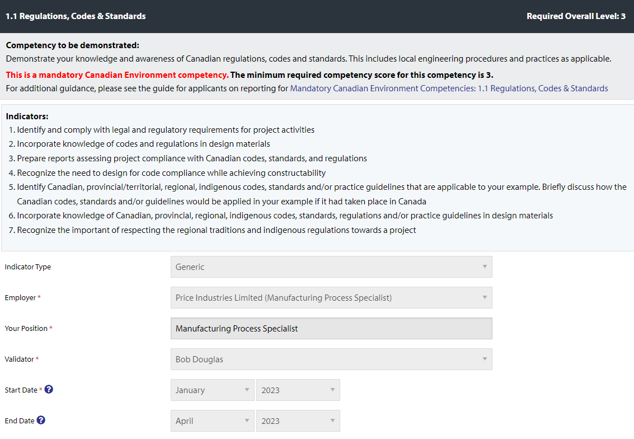
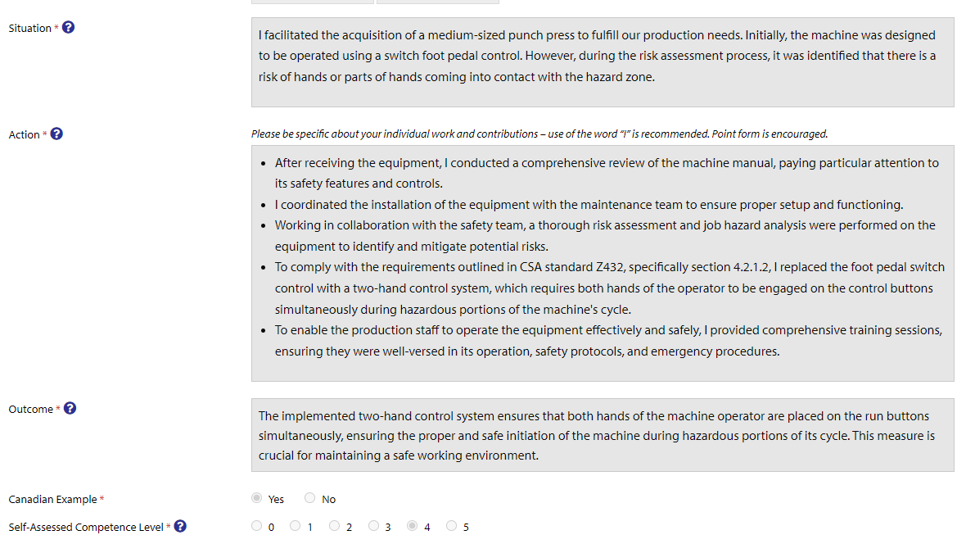
Sample Report Overview - 1

Slide 9
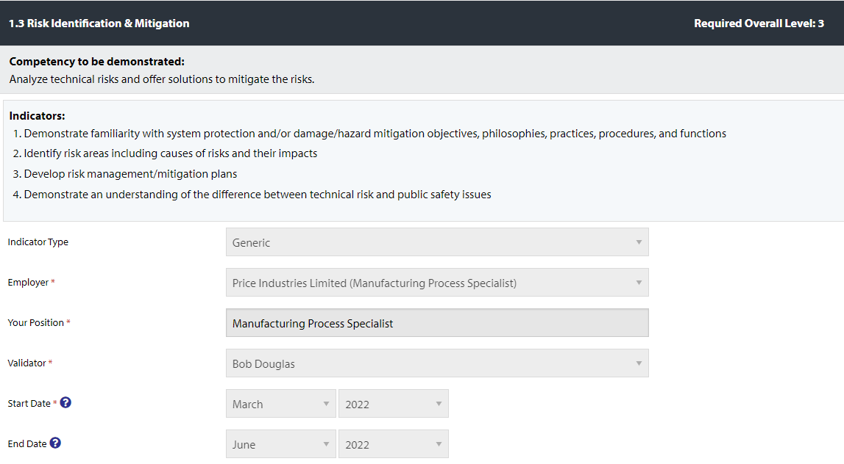
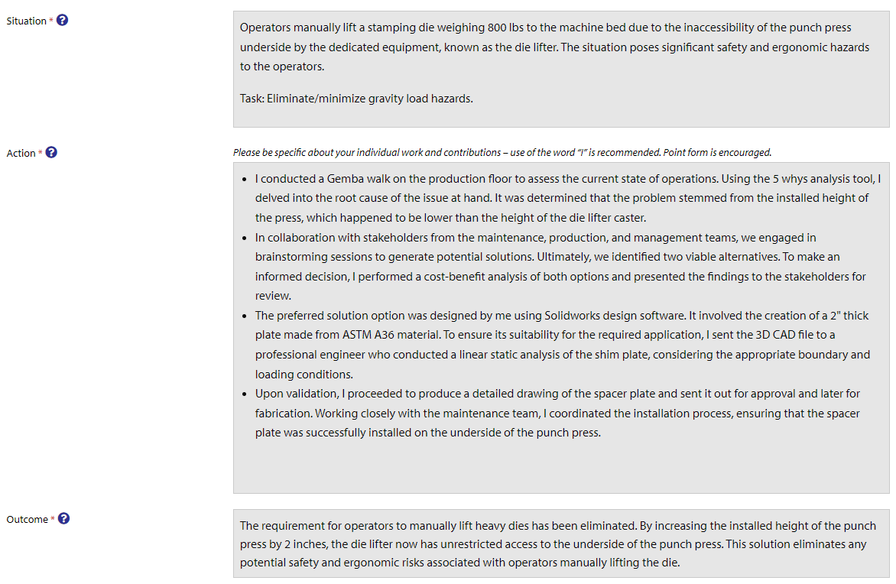
Sample Report Overview - 2

Slide 10
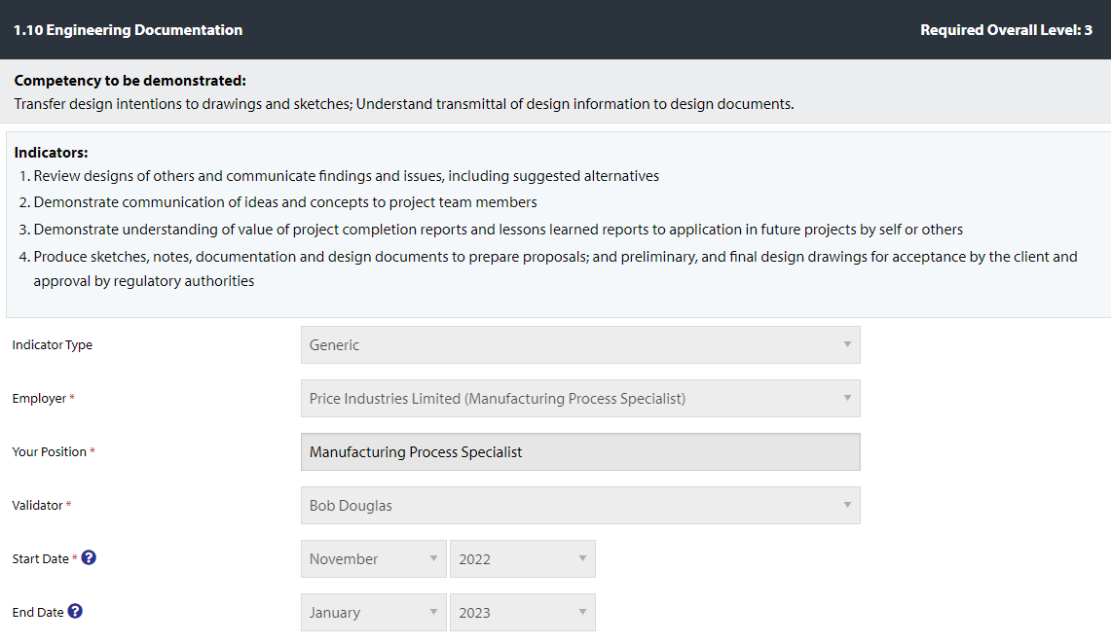
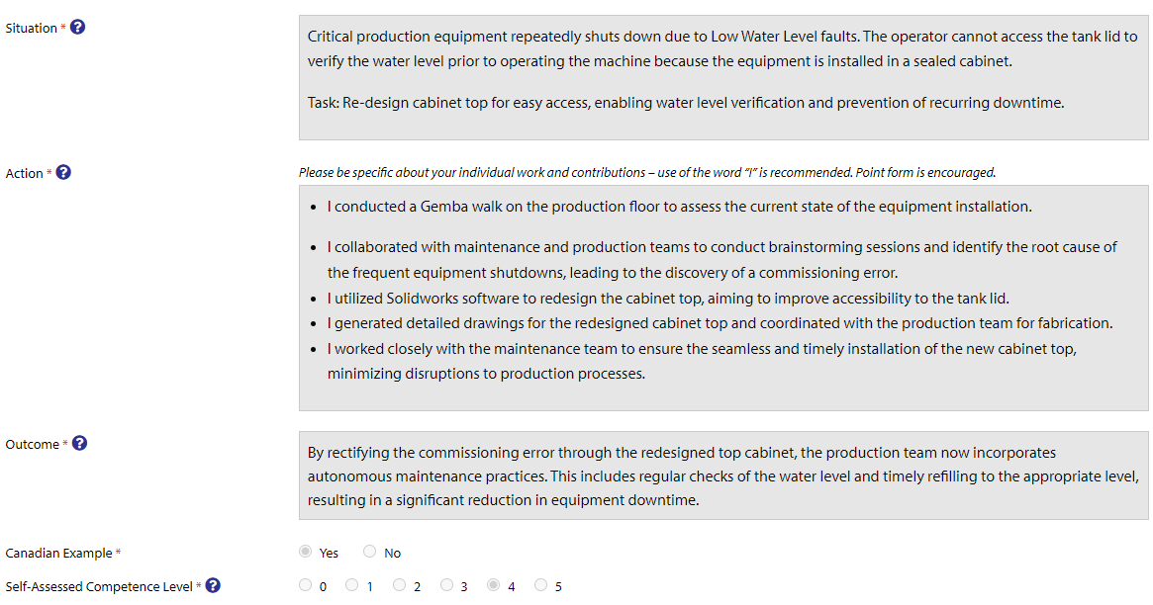
Sample Report Overview - 3

Slide 11
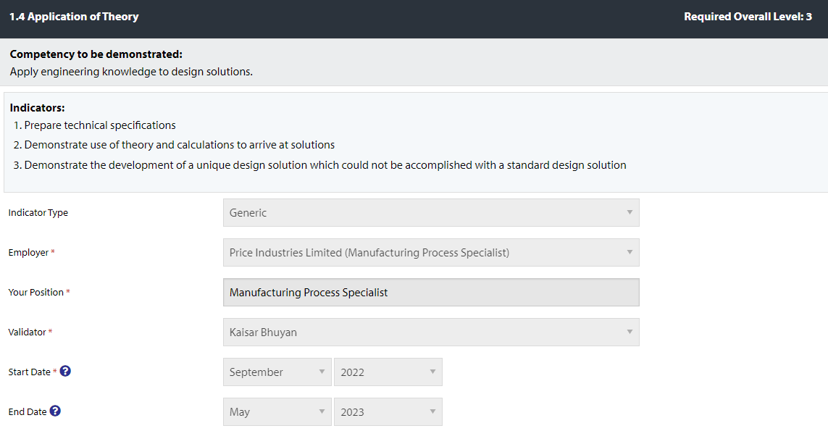
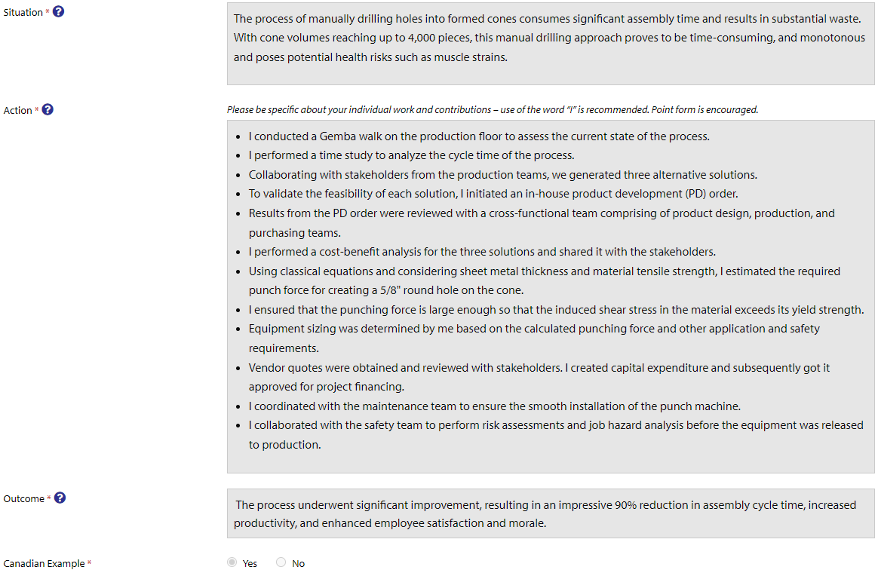
Sample Report Overview - 4

Slide 12

Conclusion
Thank you for your attention and valuable inputs!

Slide 13
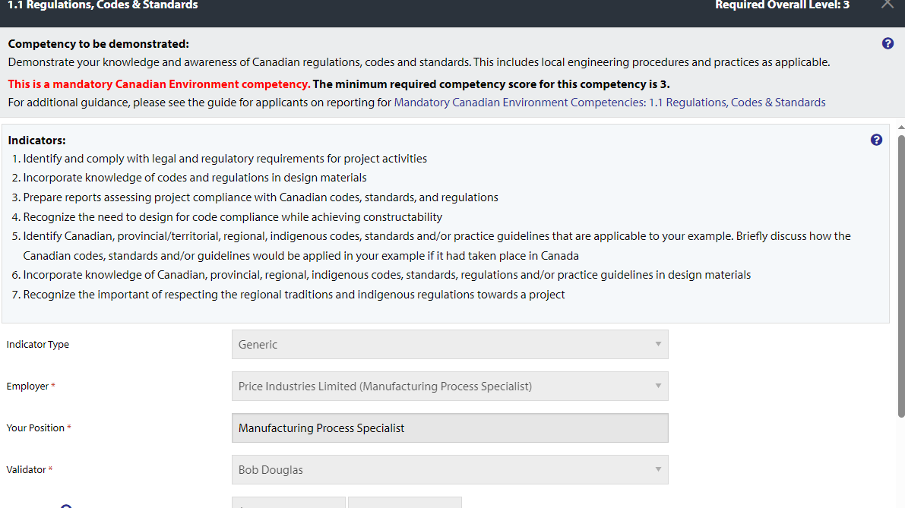

Slide 14
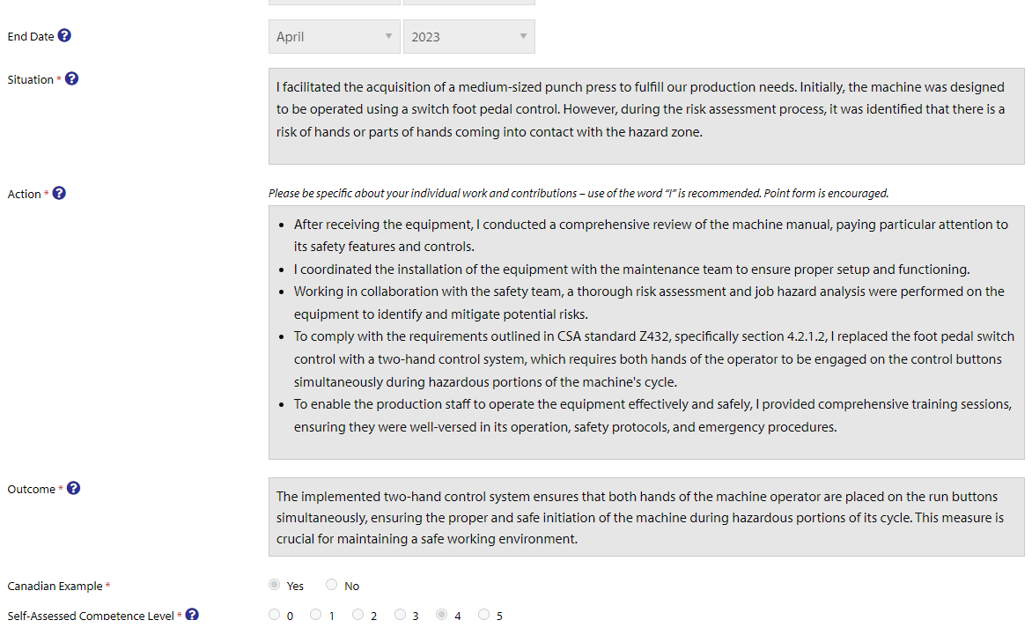

Slide 15
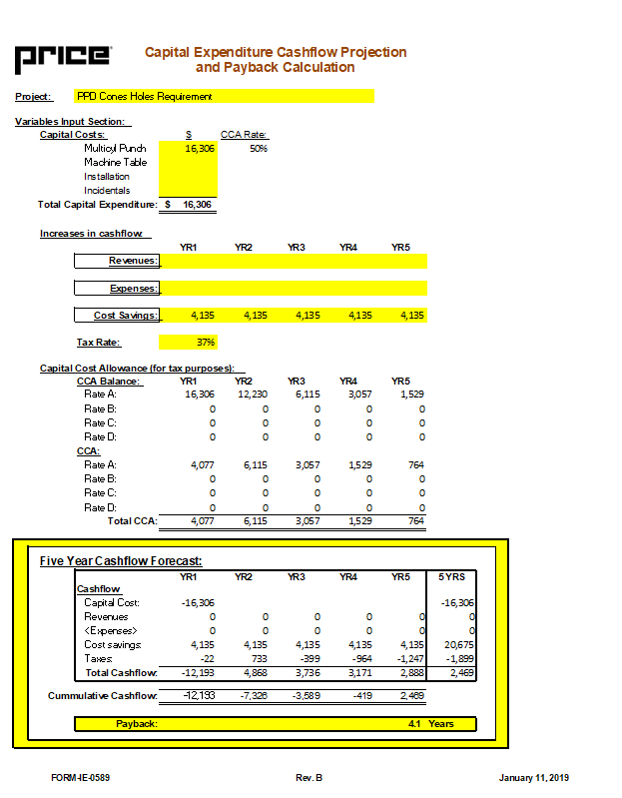

Slide 16
